Slide 1
UNIT-4 : Advanced SQL
MCA250 : Relational Database Management Systems
Semester : II MCA

Slide 2
Topics Covered:
Accessing SQL from a Programming Language.
Functions and Procedures.
Triggers.
Recursive Queries.
Advanced Aggregation Features.
OLAP.
Formal Relational Query Language:
The relational Algebra.
The Tuple Relational Calculus.
The Domain Relational Calculus.

Slide 3
Accessing SQL from a Programming Language
Dynamic SQL :
- Dynamic SQL is a programming technique that enables you to build SQL statements
dynamically at runtime.
- You can create more general purpose, flexible applications by using dynamic SQL because
the full text of a SQL statement may be unknown at compilation.
Example : dynamic SQL lets you create a procedure that operates on a table whose
name is not known until runtime.
Why Dynamic SQL ?
Static SQL statements do not change from execution to execution. The full text of static SQL statements are known at compilation, which provides the following benefits:
Successful compilation verifies that the SQL statements reference valid database objects.
Successful compilation verifies that the necessary privileges are in place to access the database objects.
Performance of static SQL is generally better than dynamic SQL.

Slide 4
When to Use Dynamic SQl?
Static SQL has limitations that can be overcome with dynamic SQL.
You may not always know the full text of the SQL statements that must be executed in a PL/SQL procedure.
Your program may accept user input that defines the SQL statements to execute, or your program may need to complete some processing work to determine the correct course of action. In such cases, you should use dynamic SQL.
In addition, dynamic SQL lets you execute SQL statements that are not supported in static SQL programs, such as data definition language (DDL) statements. Support for these statements allows you to accomplish more with your PL/SQL programs.
NOTE : The phrase dynamic SQL programs means programs that include dynamic SQL; such programs also can include static SQL. Static SQL programs are those programs that include only static SQL and no dynamic SQL.

Slide 5
Difference between SQL vs Dynamic SQL
DECLARE @tablename AS NVARCHAR(255) = N'dbo.Table';
SELECT *
FROM @tablename
( ****** this code will fail******)
Dynamic SQL Example –
Table name (FROM clause).
Database name (USE clause).
Column names (SELECT, WHERE, GROUP BY, HAVING, and ORDER
BY clauses).
Lists (IN, PIVOT clauses).

Slide 6
An example of putting the query to the string:
DECLARE @query AS NVARCHAR(255) = N'SELECT * FROM dbo.Table';
SELECT @query AS query;
An example of executing the query, which is in the string (dynamic in SQL):
DECLARE @query AS NVARCHAR(255) = N'SELECT * FROM dbo.Table';
EXEC(@query);
So as we can see, we use the EXEC statement to dynamically execute the query that store in the nvarchar variable.

Slide 7
JDBC:
JDBC stands for Java DataBase Connectivity, which is a standard Java API for database-independent connectivity between the Java programming language and a wide range of databases.
The JDBC library includes APIs for each of the tasks mentioned below that are commonly associated with database usage.
Making a connection to a database.
Creating SQL or MySQL statements.
Executing SQL or MySQL queries in the database.
Viewing & Modifying the resulting records.

Slide 8
Applications of JDBC:
Fundamentally, JDBC is a specification that provides a complete set of interfaces that allows for portable access to an underlying database. Java can be used to write different types of executables, such as −
Java Applications
Java Applets
Java Servlets
Java Server Pages (JSPs)
Enterprise JavaBeans (EJBs).
All of these different executables are able to use a JDBC driver to access a database, and take advantage of the stored data.

Slide 9
The JDBC 4.0 and Packages:
The java.sql and javax.sql are the primary packages for JDBC 4.0 and this is the latest JDBC version.
The new features in these packages include changes in the following areas −
Automatic database driver loading.
Exception handling improvements.
Enhanced BLOB/CLOB functionality.
Connection and statement interface enhancements.
National character set support.
SQL ROWID access.
SQL 2003 XML data type support.
Annotations.

Slide 10
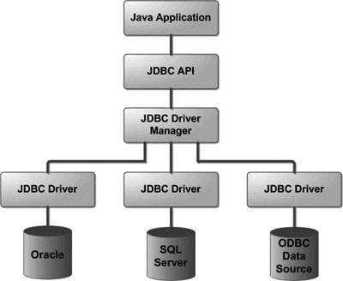
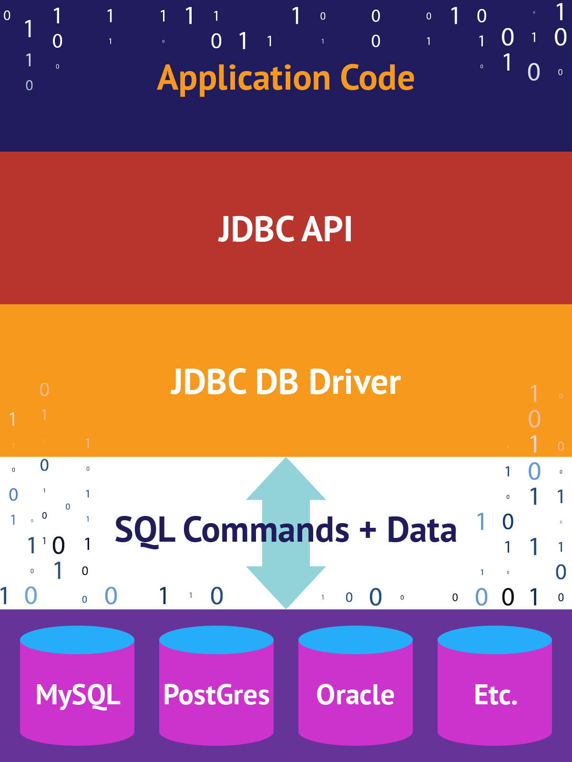
JDBC Architecture:
The JDBC API supports both two-tier and three-tier processing models for database access but in general, JDBC Architecture consists of two layers −
JDBC API: This provides the application-to-JDBC Manager connection.
JDBC Driver API: This supports the JDBC Manager-to-Driver Connection.

Slide 11
JDBC Components: ( Interfaces and Classes)
Driver Manager: This class manages a list of database drivers. Matches connection requests from the java application with the proper database driver using communication sub protocol. The first driver that recognizes a certain subprotocol under JDBC will be used to establish a database Connection.
Driver: This interface handles the communications with the database server. You will interact directly with Driver objects very rarely. Instead, you use Driver Manager objects, which manages objects of this type. It also abstracts the details associated with working with Driver objects.
Connection: This interface with all methods for contacting a database. The connection object represents communication context, i.e., all communication with database is through connection object only.
Statement: You use objects created from this interface to submit the SQL statements to the database. Some derived interfaces accept parameters in addition to executing stored procedures.
Result Set: These objects hold data retrieved from a database after you execute an SQL query using Statement objects. It acts as an iterator to allow you to move through its data.
SQL Exception: This class handles any errors that occur in a database application.

Slide 12
JDBC DRIVERS:
JDBC drivers are client-side adapters (installed on the client machine, not on the server) that convert requests from Java programs to a protocol that the DBMS can understand.
Types:
Commercial and free drivers provide connectivity to most relational-database servers. These drivers fall into one of the following types:
1. Type 1: that calls native code of the locally available ODBC driver. (Note: In JDBC 4.2,
JDBC-ODBC bridge has been removed)
2. Type 2: that calls database vendor native library on a client side. This code then talks to
database over the network.
3. Type 3: the pure-java driver that talks with the server-side middleware that then talks to
the database.
4. Type 4: the pure-java driver that uses database native protocol.

Slide 13
JDBC Connection:
The steps for connecting to a database with JDBC are as follows:
Install or locate the database you want to access.
Include the JDBC library.
Ensure the JDBC driver you need is on your class path.
Use the JDBC library to obtain a connection to the database.
Use the connection to issue SQL commands.
Close the connection when you're finished.
https://www.javatpoint.com/example-to-connect-to-the-mysql-database
https://www.vogella.com/tutorials/MySQLJava/article.html
https://www.mysqltutorial.org/connecting-to-mysql-using-jdbc-driver/

Slide 14
ODBC:
Open DataBase Connectivity (ODBC) is a standard application programming interface (API) for accessing database management systems (DBMS).
The designers of ODBC aimed to make it independent of database systems and operating systems.
An application written using ODBC can be ported to other platforms, both on the client and server side, with few changes to the data access code.
ODBC (Open Database Connectivity) works with C, C++, C#, and Visual Basic .
Applications such as GUI, spreadsheets, etc. can use ODBC .
Was defined originally for Basic and C, versions available for many languages.
Each database system supporting ODBC provides a "driver" library that must be linked with the client program.
When client program makes an ODBC API call, the code in the library communicates with the server to carry out the requested action, and fetch results.
ODBC program first allocates an SQL environment, then a database connection handle.

Slide 15
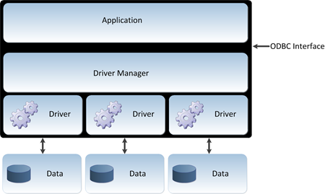
How Does it Work?
The ODBC architecture has four components:
An application, which processes and calls ODBC functions to submit SQL statements and retrieve results
A Driver Manager, which loads drivers for the application
A driver, which processes ODBC function calls, submits SQL requests to a specific data source, and returns results to the application
A data source, which consists of the data to access and its associated operating system, DBMS, and network platform (if any) used to access the DBMS
The following figure shows the relationship among the four components:

Slide 16
Bridging Configuration:
A bridge is a special kind of driver: a driver that uses another driver-based technology.
1. ODBC-to-JDBC (ODBC-JDBC) bridges:An ODBC-JDBC bridge consists of an ODBC driver which uses the services of a JDBC driver to connect to a database. This driver translates ODBC function-calls into JDBC method-calls. Programmers usually use such a bridge when they lack an ODBC driver for some database but have access to a JDBC driver. Examples: OpenLink ODBC-JDB Bridge, SequeLink ODBC-JDBC Bridge.
2. JDBC-to-ODBC (JDBC-ODBC) bridges:A JDBC-ODBC bridge consists of a JDBC driver which employs an ODBC driver to connect to a target database. This driver translates JDBC method calls into ODBC function calls. Programmers usually use such a bridge when a given database lacks a JDBC driver, but is accessible through an ODBC driver. Sun Microsystems included one such bridge in the JVM, but viewed it as a stop-gap measure while few JDBC drivers existed.
3. OLE DB-to-ODBC bridges:An OLE DB-ODBC bridge consists of an OLE DB Provider which uses the services of an ODBC driver to connect to a target database. This provider translates OLE DB method calls into ODBC function calls. Programmers usually use such a bridge when a given database lacks an OLE DB provider, but is accessible through an ODBC driver.
4. ADO.NET-to-ODBC bridges:An ADO.NET-ODBC bridge consists of an ADO.NET Provider which uses the services of an ODBC driver to connect to a target database. This provider translates ADO.NET method calls into ODBC function calls. Programmers usually use such a bridge when a given database lacks an ADO.NET provider, but is accessible through an ODBC driver.

Slide 17
ODBC database connections
Connect to the database.
Prepare a query (as a string).
Execute the query.
Fetch the results (as an array of rows).
Finish the query (so that DB can clean up its buﬀers).
Disconnect from the database.
Steps:
To Connect:
CONNECT TO < Server Name > As < Connection name> ;
AUTHORIZATION < User Account Name and Password >;
To Disconnect:
SET Connection < Connection Name>;
DICONNECT < Connection Name>;

Slide 18
EMBEDDED SQL:
Embedded SQL is a method of combining the computing power of a programming language and the database manipulation capabilities of SQL.
Embedded SQL statements are SQL statements written inline with the program source code, of the host language.
SQL can be embedded within procedural programming languages. These languages include
C/C++, Java, Perl, Python, and PHP.
Embedded SQL supports:
Highly customised applications.
Background applications running without user intervention.
Combining database tools with programming tools.
Databases on the WWW

Slide 19
Two types of embedding
Low-level embedding (eg. C/C++):
- SQL and program compiled into a single executable.
- Very eﬃcient link.
ODBC - Open Database Connectivity (eg. PHP/Java):
SQL query sent from the program to the database as a string.
Results returned as an array or list.
Independence of program and database:
- Each language has one DBI (database interface) for all DBMS types. (For example, JDBC
for Java.)
- Separate database drivers (DBD) for each DBMS type.

Slide 20
Syntax:
EXEC SQL statement is used to identify embedded SQL request to the pre-processor:
EXEC SQL <embedded SQL statement > END_EXEC
NOTE: this varies by language (for example, the Java embedding uses # SQL { …. }; )
Need for Embedded SQL in DBMS:
The result of a query is made available to the program which is embedded as one tuple or record at a time
For identification of this, we request to the pre-processor via EXEC SQL statement: EXEC SQL embedded SQL statement END-EXEC
Its statements are declare cursor, fetch and open statements.
It can execute the update, insert a delete statement

Slide 21
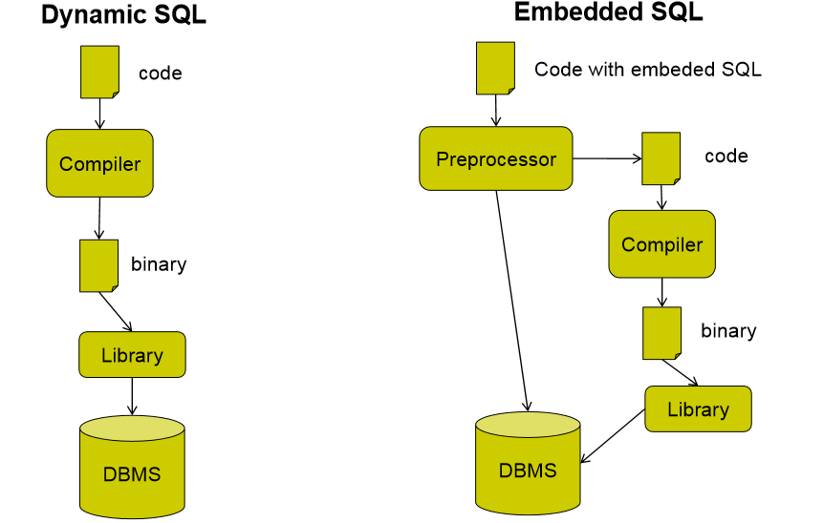
Dynamic vs. Embedded SQL

Slide 22
EMBEDDED(STATIC) SQL | DYNAMIC (INTERACTIVE) SQL
In Static SQL, how database will be accessed is predetermined in the embedded SQL statement. | In Dynamic SQL, how database will be accessed is determined at run time.
It is more swift and efficient. | It is less swift and efficient.
SQL statements are compiled at compile time. | SQL statements are compiled at run time.
Parsing, Validation, Optimization and Generation of application plan are done at compile time. | Parsing, Validation, Optimization and Generation of application plan are done at run time.
It is generally used for situations where data is distributed uniformly. | It is generally used for situations where data is distributed non uniformly.
EXECUTE IMMEDIATE, EXECUTE and PREPARE statements are not used. | EXECUTE IMMEDIATE, EXECUTE and PREPARE statements are used.
It is less flexible. | It is more flexible.

Slide 23
Functions and procedures:
"A Procedures or Functions is a group or set of SQL or PL/SQL statements that perform a specific task.“
A function and procedure is a named PL/SQL Block which is similar . The major difference between a procedure and a function is, a function must always return a value, but a procedure may or may not return a value
SQL:1999 supports functions and procedures:
Functions/procedures can be written in SQL itself, or in an external programming language.
Functions are particularly useful with specialized data types such as images and geometric objects.
Example: functions to check if polygons overlap, or to compare images for similarity.

Slide 24
Procedures:
A procedure has a header and a body.
The header consists of the name of the procedure and the parameters or variables passed to the procedure.
The body consists or declaration section, execution section and exception section similar to a general PL/SQL Block. A procedure is similar to an anonymous PL/SQL Block but it is named for repeated usage.
We can pass parameters to procedures in three ways :
NOTE : A procedure may or may not return any value.
Parameters | Description
IN type | These types of parameters are used to send values to stored procedures.
OUT type | These types of parameters are used to get values from stored procedures. This is similar to a return type in functions.
IN OUT type | These types of parameters are used to send values and get values from stored procedures.

Slide 25
Syntax:
CREATE [OR REPLACE] PROCEDURE procedure name (<Argument> {IN, OUT, IN OUT} <Data type>,…)
IS
Declaration section<variable, constant> ;
BEGIN
Execution section
EXCEPTION
Exception section
END
IS - marks the beginning of the body of the procedure and is similar to DECLARE in anonymous PL/SQL Blocks.
The code between IS and BEGIN forms the Declaration section. The syntax within the brackets [ ] indicate they are optional.
By using CREATE OR REPLACE together the procedure is created if no other procedure with the same name exists or the existing procedure is replaced with the current code.

Slide 26
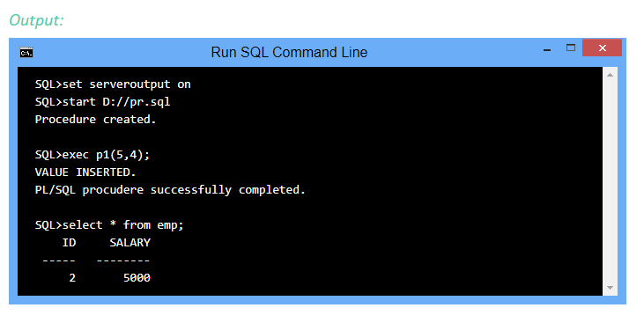
Example:
CREATE OR REPLACE PROCEDURE p1(id IN NUMBER, sal IN NUMBER)
AS
BEGIN
INSERT INTO emp VALUES(id, sal);
DBMD_OUTPUT.PUT_LINE('VALUE INSERTED.');
END;

Slide 27
Functions:
A function is a named PL/SQL Block which is similar to a procedure. The major difference between a procedure and a function is, a function must always return a value, but a procedure may or may not return a value.
Syntax:
CREATE [OR REPLACE] FUNCTION function name [parameters]
RETURN return_datatype; {IS, AS}
Declaration section <variable,constant> ;
BEGIN
Execution_section
Return return_variable;
EXCEPTION
exception section
Return return_variable;
END;

Slide 28
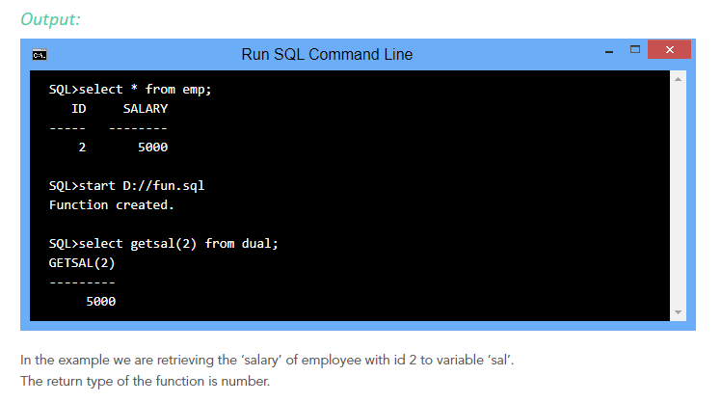
Example:
create or replace function getsal (no IN number) return number
is
sal number(5);
begin
select salary into sal from emp where id=no;
return sal;
end;

Slide 29
Procedures VS Functions:
A function MUST return a value
A procedure cannot return a value
Procedures and functions can both return data in OUT and IN OUT parameters
The return statement in a function returns control to the calling program and returns the results of the function
The return statement of a procedure returns control to the calling program and cannot return a value
Functions can be called from SQL, procedure cannot
Functions are considered expressions, procedure are not

Slide 30
TRIGGERS:
A trigger is a special type of stored procedure that automatically runs when an event occurs in the database server.
Triggers are, in fact, written to be executed in response to any of the following events −
A database manipulation (DML) statement (DELETE, INSERT, or UPDATE)
A database definition (DDL) statement (CREATE, ALTER, or DROP).
A database operation (SERVERERROR, LOGON, LOGOFF, STARTUP, or SHUTDOWN).
The SQL standard defines two types of triggers: row-level triggers and statement-level triggers.
A row-level trigger is activated for each row that is inserted, updated, or deleted. For example, if a table has 100 rows inserted, updated, or deleted, the trigger is automatically invoked 100 times for the 100 rows affected.
A statement-level trigger is executed once for each transaction regardless of how many rows are inserted, updated, or deleted.

Slide 31
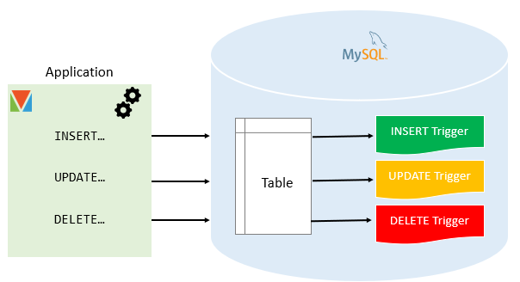
MySQL supports only row-level triggers. It doesn’t support statement-level triggers.
NOTE : Triggers can be defined on the table, view, schema, or database with which the event is associated.

Slide 32
Syntax:The following illustrates the syntax of the CREATE TRIGGER statement:
CREATE TRIGGER [schema_name.]trigger_name
ON table_name
AFTER {[INSERT],[UPDATE],[DELETE]}
[NOT FOR REPLICATION]
AS
{sql_statements};
In this syntax:
The schema_name is the name of the schema to which the new trigger belongs. The schema name is optional.
The trigger_name is the user-defined name for the new trigger.
The table_name is the table to which the trigger applies.
The event is listed in the AFTER clause. The event could be INSERT, UPDATE, or DELETE. A single trigger can fire in response to one or more actions against the table.
The NOT FOR REPLICATION option instructs SQL Server not to fire the trigger when data modification is made as part of a replication process.
The sql_statements is one or more Transact-SQL used to carry out actions once an event occurs.

Slide 33
Managing MySQL triggers:
Trigger Type | Descriptions
Create Triggers | describe steps of how to create a trigger in MySQL
Drop Triggers | show you how to drop a trigger.
Create a BEFORE INSERT trigger | show you how to create a BEFORE INSERT trigger to maintain a summary table from another table.
Create an AFTER INSERT trigger | describe how to create an AFTER INSERT trigger to insert data into a table after inserting data into another table.
Create a BEFORE UPDATE trigger | learn how to create a BEFORE UPDATE trigger that validates data before it is updated to the table.
Create an AFTER UPDATE trigger | show you how to create an AFTER UPDATE trigger to log the changes of data in a table.
Create a BEFORE DELETE trigger | show how to create a BEFORE DELETE trigger.
Create an AFTER DELETE trigger | describe how to create an AFTER DELETE trigger.
Show triggers | list triggers in a database, table by specific patterns.

Slide 34
Benefits of Triggers:
Triggers can be written for the following purposes −
Generating some derived column values automatically.
Enforcing referential integrity.
Event logging and storing information on table access.
Auditing.
Synchronous replication of tables.
Imposing security authorizations.
Preventing invalid transactions.

Slide 35
Disadvantages of triggers:
Triggers can only provide extended validations, not all validations. For simple validations, you can use the NOT NULL, UNIQUE, CHECK and FOREIGN KEY constraints.
Triggers can be difficult to troubleshoot because they execute automatically in the database, which may not invisible to the client applications.
Triggers may increase the overhead of the MySQL Server.

Slide 36
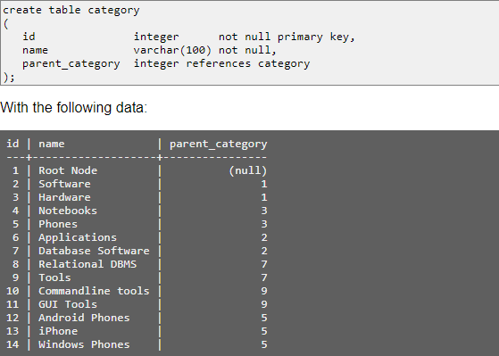
Recursive Queries:
Recursive queries are used to query hierarchical data. The SQL standard defines a special syntax for common table expressions to enable recursive processing.
Assume the following hierarchical definition of product categories:

Slide 37
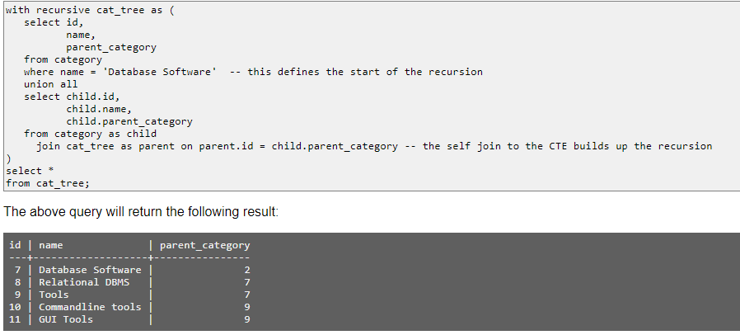
To (recursively) query all sub-categories for one parent, the following query can be used:https ://www.sql-workbench.eu/comparison/recursive_queries.html

Slide 38
Advanced Aggregate Features: ( Assignment-4)
In addition to the aggregations covered in the intermediate section, there are also Boolean aggregations, statistical aggregations, and regression aggregations.
URL : https://docs.data.world/documentation/sql/concepts/advanced/aggregate_functions.html.
Boolean Aggregations;
1. BOOL_AND 2. BOOL_OR
Statistical Aggregations:
1. CORRELATION 2. COVAR POP 3. COVAR SAMP 4. STD POP 5. STD SAMP
6. STDEV 7. VAR POP 8.VAR SAMP 9.VARIANCE
Regression aggregations:
1. REGR_AVGX 2. REGR_AVGY 3. REGR_COUNT 4. REGR_INTERCEPT
5. REGR_R2 6.REGR_SLOPE 7.REGR_SXX 8.REGR_SXY 9.REGR_SYY

Slide 39
OLAP:
Online Analytical Processing Server (OLAP) is based on the multidimensional data model. It allows managers, and analysts to get an insight of the information through fast, consistent, and interactive access to information.
Types of OLAP Servers:
We have four types of OLAP servers −
Relational OLAP (ROLAP): ROLAP servers are placed between relational back-end server and client front-end tools. To store and manage warehouse data, ROLAP uses relational or extended-relational DBMS.
Multidimensional OLAP (MOLAP): MOLAP uses array-based multidimensional storage engines for multidimensional views of data. With multidimensional data stores, the storage utilization may be low if the data set is sparse. Therefore, many MOLAP server use two levels of data storage representation to handle dense and sparse data sets.
Hybrid OLAP (HOLAP): Hybrid OLAP is a combination of both ROLAP and MOLAP. It offers higher scalability of ROLAP and faster computation of MOLAP. HOLAP servers allows to store the large data volumes of detailed information. The aggregations are stored separately in MOLAP store.
Specialized SQL Servers: Specialized SQL servers provide advanced query language and query processing support for SQL queries over star and snowflake schemas in a read-only environment.

Slide 40
OLAP Operations: https://www.tutorialspoint.com/dwh/dwh_olap.htm
Since OLAP servers are based on multidimensional view of data, we will discuss OLAP operations in multidimensional data.
Here is the list of OLAP operations −
1.Roll-up: Roll-up performs aggregation on a data cube in any of the following ways −
-By climbing up a concept hierarchy for a dimension
-By dimension reduction
2. Drill-down: Drill-down is the reverse operation of roll-up. It is performed by either of the following ways −
-By stepping down a concept hierarchy for a dimension
-By introducing a new dimension.
3. Slice and dice: The slice operation selects one particular dimension from a given cube and provides a new sub-cube. Dice selects two or more dimensions from a given cube and provides a new sub-cube
4. Pivot (rotate): The pivot operation is also known as rotation. It rotates the data axes in view in order to provide an alternative presentation of data.

Slide 41
OLAP vs oltp
Sr.No. | Data Warehouse (OLAP) | Operational Database (OLTP)
1 | Involves historical processing of information. | Involves day-to-day processing.
2 | OLAP systems are used by knowledge workers such as executives, managers and analysts. | OLTP systems are used by clerks, DBAs, or database professionals.
3 | Useful in analyzing the business. | Useful in running the business.
4 | It focuses on Information out. | It focuses on Data in.
5 | Based on Star Schema, Snowflake, Schema and Fact Constellation Schema. | Based on Entity Relationship Model.
6 | Contains historical data. | Contains current data.
7 | Provides summarized and consolidated data. | Provides primitive and highly detailed data.
8 | Provides summarized and multidimensional view of data. | Provides detailed and flat relational view of data.
9 | Number or users is in hundreds. | Number of users is in thousands.
10 | Number of records accessed is in millions. | Number of records accessed is in tens.
11 | Database size is from 100 GB to 1 TB | Database size is from 100 MB to 1 GB.
12 | Highly flexible. | Provides high performance.

Slide 42
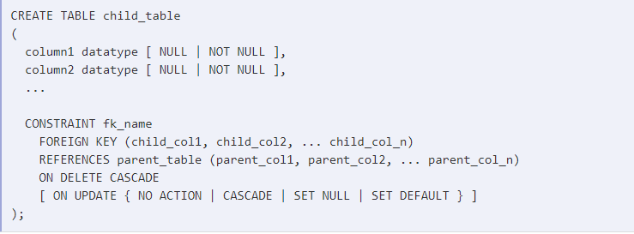
Cascade:
How to use Foreign Keys with cascade delete in SQL Server with syntax and examples ?
A foreign key with cascade delete means that if a record in the parent table is deleted, then the corresponding records in the child table will automatically be deleted. This is called a cascade delete in SQL Server.
NOTE: A foreign key with cascade delete can be created using either a CREATE TABLE statement or an ALTER TABLE statement.
The syntax for creating a foreign key with cascade delete using a CREATE TABLE statement in SQL Server :

Slide 43
child_table: The name of the child table that you wish to create.
column1, column2:The columns that you wish to create in the table. Each column must have a datatype. The column should either be defined as NULL or NOT NULL and if this value is left blank, the database assumes NULL as the default.
fk_name: The name of the foreign key constraint that you wish to create.
child_col1, child_col2, ... child_col_n: The columns in child_table that will reference a primary key in the parent_table.
parent_table: The name of the parent table whose primary key will be used in the child_table.
parent_col1, parent_col2, ... parent_col3: The columns that make up the primary key in the parent_table. The foreign key will enforce a link between this data and the child_col1, child_col2, ... child_col_n columns in the child_table.
ON DELETE CASCADE: It specifies that the child data is deleted when the parent data is deleted.
ON UPDATE: Optional. It specifies what to do with the child data when the parent data is updated. You have the options of NO ACTION, CASCADE, SET NULL, or SET DEFAULT.
NO ACTION : it is used in conjunction with ON DELETE or ON UPDATE. It means that no action is performed with the child data when the parent data is deleted or updated.
CASCADE: It is used in conjunction with ON DELETE or ON UPDATE. It means that the child data is either deleted or updated when the parent data is deleted or updated.
SET NULL: It is used in conjunction with ON DELETE or ON UPDATE. It means that the child data is set to NULL when the parent data is deleted or updated.
SET DEFAULT: It is used in conjunction with ON DELETE or ON UPDATE. It means that the child data is set to their default values when the parent data is deleted or updated.

Slide 44
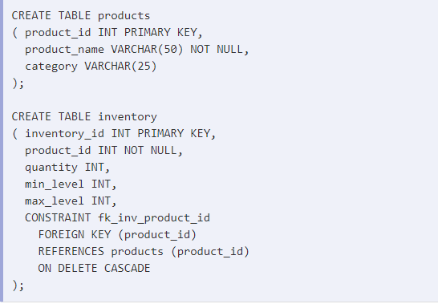
Example:
In this foreign key example, we've created our parent table as the products table. The products table has a primary key that consists of the product_id field.
Next, we've created a second table called inventory that will be the child table in this foreign key with cascade delete example. We have used the CREATE TABLE statement to create a foreign key on the inventory table called fk_inv_product_id. The foreign key establishes a relationship between the product_id column in the inventory table and the product_id column in the products table.
For this foreign key, we have specified the ON DELETE CASCADE clause which tells SQL Server to delete the corresponding records in the child table when the data in the parent table is deleted. So in this example, if a product_id value is deleted from the products table, the corresponding records in the inventory table that use this product_id will also be deleted.

Slide 45
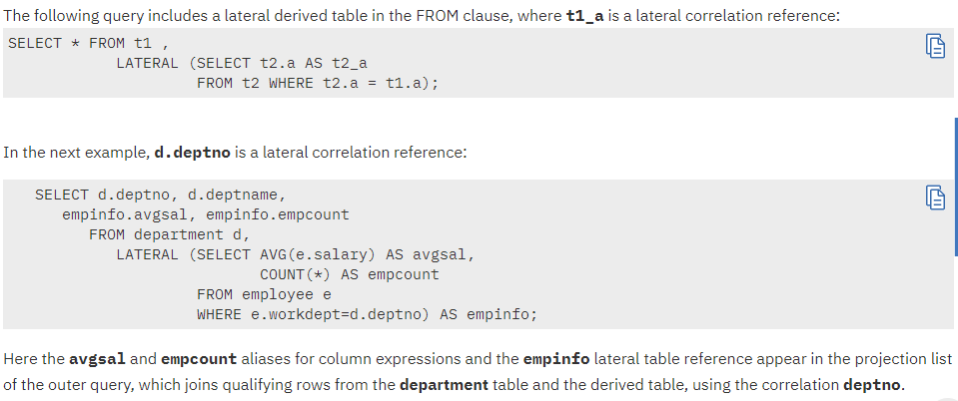
Lateral clause:
The LATERAL keyword must immediately precede any query in the FROM clause that defines a derived table, if that query references any other table or column that appears earlier in the same FROM clause than the query that defines the derived table.

Slide 46
Self study:
SQL – Indexes.
SQL - TOP, LIMIT or ROWNUM Clause.
SQL - Wildcard Operators.
SQL - TRUNCATE TABLE Command.
SQL - Date Functions.( 58 Types)
SQL – Injection.

Slide 47
Formal Relational Query Language:
Relational Algebra: is a procedural query language, which takes instances of relations as input and yields instances of relations as output. It uses operators to perform queries. An operator can be either unary or binary.
Basic Relational Algebra Operations: Relational Algebra divided in various groups:
Unary Relational Operations
SELECT (symbol: σ)
PROJECT (symbol: π)
RENAME (symbol: ρ)
Relational Algebra Operations From Set Theory
UNION (υ)
INTERSECTION (∩)
SET DIFFERENCE (-)
CARTESIAN PRODUCT ( x )
Binary Relational Operations
JOIN
DIVISION

Slide 48
Select(symbol: σ) :
The SELECT operation is used for selecting a subset of the tuples according to a given selection condition.
The selection condition acts a s a filter, keeps only those tuples that satisfy the qualifying condition.
Tuples satisfying the condition are selected values whereas the other tuples are discarded(filtered out).
In general, the relational operators like =,#,<,>,>=,<= are used to predicate or selection condition.
The general form of SELECT operation is as follows:
σ < SELECT Condition > ( R )
Where,
σ – is used to denote SELECT operator.
Selection condition is a Boolean Expression specified on the attributes of Relation ( R ).

Slide 49
SELECT condition may have,
< Attrbute_name> <comparison Operator> <Constant Value>
OR
<Attribute_name> <Comparison Operator> <Attribute_Name>
Clauses can be arbitrarily connected by the Boolean Operators AND,OR and NOT to form a general selection condition.
Example :
σ ( Dep_no=4 AND Salary>25000) OR ( Dep_no=5 AND Salary>30000) ( EMPLOYEE).

Slide 50
SELECT operation is cumulative,
σ<condition-1> (σ< Condition-2> ( R ) ) = σ< Condition-2> (σ< Condition-1> ( R ) ).
Here, a sequence of SELECT’s can be applied in any order.
In addition , we can always combine a CASCADE of SELECT operations into single SELECT operation with a Conjunctive(AND) condition, i.e.,
σ< Conditon-1> (σ< Condition-2> (….(σ< Condition-n> ( R ) ) … ))
= σ< Condition-1> AND < Condition-2> AND…..AND< Condition-n> ( R ).

Slide 51
PROJECT (symbol: π)
[ the SELECT operation selects some of the rows from the table while discarding other rows]
The PROJECT operation selects certain columns from the table and discards the other columns.
PROJECTION is denoted by Greek Letter Pi ( π ).
The general form of the PROJECT operation is,
π < Attribute List > ( R ).
The PROJECT operation removes any duplicate tuples, so the result of the PROJECT operation is a set of tuples.
Example:
π Lname, Fname, Salary ( EMPLOYEE ).
NOTE : when implemented in SQL standard the "default projection" returns a multi-set instead of a set, and the π projection to eliminate duplicate data is obtained by the addition of the DISTINCT keyword.
Cummutativity does not hold in PROJECT operation.

Slide 52
RENAME (symbol: ρ)
Is used to RENAME either relation name or attributes names or both.- as a unary operator.
The general form is as follows,
ρ S ( a1,a2,a3,,,,,,,, an) ( R )
OR
ρ S( R )
OR
ρ ( a1,a2,a3….an) ( R )
Where,
ρ indicates RENAME Operation and S indicates New Relation name or Attributes Names.
In the above syntax:
The first expression renames both the relation and its attributes.
The second expression renames the relations only.
The third expression renames the attributes only.

Slide 53
Relational Algebra Operations From Set Theory
UNION ( Symbol-υ): It includes all tuples that are in tables A or in B. It also eliminates duplicate tuples. So, set A UNION set B would be expressed as:
A ∪ B
For a union operation to be valid, the following conditions must hold
A and B must be the same number of attributes.
Attribute domains need to be compatible.
Duplicate tuples should be automatically removed.
UNION is a Cumulative Operation:
A U B = B U A
Also, Associative Operation:
A U ( B U T ) = ( A U B ) U T

Slide 54
INTERSECTION (Symbol-∩),
Defines a relation consisting of a set of all tuple that are in both A and B. However, A and B must be union-compatible.
An INTERSECTION is defined by the symbol- ∩
A ∩ B
It’s a Cummulative Operation:
A ∩ B = B ∩ A
It’s a Associative Operations:
A ∩ ( B ∩ T ) = ( A ∩ B ) ∩ T
Can also be expressed in terms of UNION and SET-DIFFERENCE :
A ∩ B = A U B – ( A – B ) – ( B – A )

Slide 55
SET DIFFERENCE (Symbol: - )
is a relation which includes all tuples that are in A but not in B.
- Symbol denotes it.
A – B
NOTE : SET DIFFERENCE is not CUMMULATIVE. ( A – B # B – A)
Cartesian Product/Cross Product ( Symbol- χ )
This type of operation is helpful to merge columns from two relations. Generally, a Cartesian product is never a meaningful operation when it performs alone.
A χ B
NOTE: Cartesian Product operations relations need not have to be union compatible.

Slide 56
JOIN Operations( Symbol- ⋈ ) :
Join operation is essentially a Cartesian product followed by a selection criterion.
Join operation denoted by ⋈. A ⋈ B
NOTE : This operation is a very important for any relational database with more than a single relation because it allows us to process relationships among relations.
A general JOIN condition is of the form:
< Condition> AND < Condition> AND….. AND < Condition>
where, Each condition here is of the form Ai ϴ Bj .
Here, Ai – attribute of A , Bj – attribute of B and Both have the same domain.
NOTE: Ai and Bj must have same domain then only we can Combine. Hence is called as THETA JOIN.

Slide 57
TYPES of joins:
Various forms of join operation are:
Inner Joins:
Theta join
EQUI join
Natural join
Outer join:
Left Outer Join
Right Outer Join
Full Outer Join

Slide 58
INNER JOINS:
In an inner join, only those tuples that satisfy the matching criteria are included, while the rest are excluded. Let's study various types of Inner Joins:
THETA JOIN: The general case of JOIN operation is called a Theta join. It is denoted by symbol θ :
A ⋈ θ B
Example : A ⋈ A.column 2 > B.column 2 (B)
Here θ, is one of the comparison operators ( =, <,>,<=,>=,#)
EQUI JOIN: When a theta join uses only equivalence condition, it becomes a EQUI JOIN.
Example : A ⋈ A.column 2 = B.column 2 (B)
NATURAL JOIN (⋈): Natural join can only be performed if there is a common attribute (column) between the relations. The name and type of the attribute must be same.

Slide 59
Outer joins:
In an outer join, along with tuples that satisfy the matching criteria, we also include some or all tuples that do not match the criteria.
LEFT OUTER JOIN (A B) : In the left outer join, operation allows keeping all tuple in the left relation. However, if there is no matching tuple is found in right relation, then the attributes of right relation in the join result are filled with null values.
RIGHT OUTER JOIN ( A B ): In the right outer join, operation allows keeping all tuple in the right relation. However, if there is no matching tuple is found in the left relation, then the attributes of the left relation in the join result are filled with null values.
FULL OUTER JOIN (A B): In a full outer join, all tuples from both relations are included in the result, irrespective of the matching condition.

Slide 60
DIVISION Operation:
The division is a binary operation that is written as A ÷ B.
Division is not implemented directly in SQL.
The result consists of the restrictions of tuples in A to the attribute names unique to A, i.e., in the header of A but not in the header of B, for which it holds that all their combinations with tuples in B are present in A.
Attributes of B is proper subset of Attributes of A.
Syntax :
A ÷ B = { t[a1,...,an] : t ∈ A ∧ ∀s ∈ B ( (t[a1,...,an] ∪ B) ∈ A) }
where
{a1,...,an} is the set of attribute names unique to A .
t[a1,...,an] is the restriction of t to this set.
It is usually required that the attribute names in the header of B are a subset of those of A because otherwise the result of the operation will always be empty

Slide 61
SUMMARY
Operation | Purpose
Select(σ) | The SELECT operation is used for selecting a subset of the tuples according to a given selection condition
Projection(π) | The projection eliminates all attributes of the input relation but those mentioned in the projection list.
Union Operation(∪) | UNION is symbolized by symbol. It includes all tuples that are in tables A or in B.
Set Difference(-) | Symbol denotes it. The result of A - B, is a relation which includes all tuples that are in A but not in B.
Intersection(∩) | Intersection defines a relation consisting of a set of all tuple that are in both A and B.
Cartesian Product(X) | Cartesian operation is helpful to merge columns from two relations.
Inner Join | Inner join, includes only those tuples that satisfy the matching criteria.
Theta Join(θ) | The general case of JOIN operation is called a Theta join. It is denoted by symbol θ.
EQUI Join | When a theta join uses only equivalence condition, it becomes a equi join.
Natural Join(⋈) | Natural join can only be performed if there is a common attribute (column) between the relations.
Outer Join | In an outer join, along with tuples that satisfy the matching criteria.
Left Outer Join( ) | In the left outer join, operation allows keeping all tuple in the left relation.
Right Outer join() | In the right outer join, operation allows keeping all tuple in the right relation.
Full Outer Join() | In a full outer join, all tuples from both relations are included in the result irrespective of the matching condition.

Slide 62
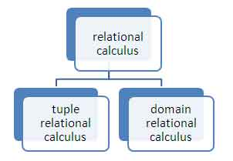
Relational Calculus:
In the previous section, we discussed Relational Algebra which is a procedural query language. In this section, we will discuss Relational Calculus, which is a non-procedural query language.
Relational calculus is a non-procedural query language that tells the system what data to be retrieved but doesn’t tell how to retrieve it.
In the relational calculus, there is no description of how to evaluate a query; a relational calculus query speciﬁes what is to be retrieved rather than how to retrieve it. The relational calculus is not related to differential and integral calculus in mathematics, but takes its name from a branch of symbolic logic called predicate calculus.
Types of Relational Calculus:

Slide 63
Tuple Relational Calculus (TRC)
Tuple relational calculus is used for selecting those tuples that satisfy the given condition.
Notation − { T | Condition}.
In this form of relational calculus, we define a tuple variable, specify the table(relation) name in which the tuple is to be searched for, along with a condition.
Returns all tuples T that satisfies a condition.
Example :
{ T.name | Author(T) AND T.article = 'database' }
Returns tuples with 'name' from Author who has written article on 'database'.
TRC can be quantified. We can use Existential (∃) and Universal Quantifiers (∀).
Example :
{ R| ∃T ∈ Authors(T.article='database' AND R.name=T.name)}
The above query will yield the same result as the previous one.

Slide 64
Domain Relational Calculus (DRC)
In domain relational calculus the records are filtered based on the domains.
Syntax: { c1, c2, c3, ..., cn | F(c1, c2, c3, ... ,cn)}
where, c1, c2... etc represents domain of attributes(columns) and F defines the formula including the condition for fetching the data.
Example:
{< name, age > | ∈ Student ∧ age > 17}
the above query will return the names and ages of the students in the table Student who are older than 17.
Just like TRC, DRC can also be written using Existential and Universal quantifiers. DRC also involves relational operators.
The expression power of Tuple Relation Calculus and Domain Relation Calculus is equivalent to Relational Algebra.

Slide 65
Propositions:
Propositions is just a statement , that can be either true or false.
It Could be “ Tendulkar has batted in match 2755” or “ Shane Warne was born in Melbourne”. These are atomic propositions and they may be denoted by symbols like A and B and their value is either TRUE or FALSE.
Two are more atomic propositions leads to COMPOUND Propositions.
A Compound proposition with two components may be of the type ( A AND B ) or it may be of the type ( A OR B ), Such Propositions are called FORMULAS.
When a sequence of propositions is joined by AND’s , we call it a CONJUNCTION of propositions and the conjunction is true only if all atomic propositions are true.
Similarly, when a sequence of propositions are joined by OR’s, we call it a DISJUNCTION of propositions and disjunction is true when at least one of the atomic propositions is true and false only when all the propositions are false.
Example : De-Morgan’s Laws
NOT ( A AND B ) = ( NOT A ) OR ( NOT B )
NOT ( A OR B ) = ( NOT A ) AND ( NOT B )

Slide 66
The IMPLIEs operator ( ) :
A B.
The above notation can be quite useful in logical reasoning but is limited in its power of expression.
Here , reasoning is based on TWO rules:
If A is true and we are given A B, then B must be true.
If A B and B C , then A C.
The first rule is called as MODUS PONENS.
The second rule is called as CHAIN RULE.

Slide 67
Example:
Consider the below given propositions:
If it rains (A), it must be cloudy (B).
If it is cloudy (B), I don't play golf (C) .
It is raining ( A ).
Derive- I don’t play golf ( C ) .
The above propositions can be written using IMPLIES operator as:
A B.
B C.
A is true.
B is therefore true given A B.
C is therefore true given B C.
Sometimes we may face a situation, such that the proposition that we wish to prove can be shown to be true for all values of atomic propositions in it . Such a proposition are called as TAUTOLOGY.
A Parameterized Proposition is called as PREDICATE.

Slide 68
Thank you

